Slide 1
Homework 2
COSE331 Computer Graphics

Slide 2
Goal
Implementing forward kinematics
Apply skinning on the mesh
Interpolate the animation between key frames
Implement Object rotating (optional)

Slide 3
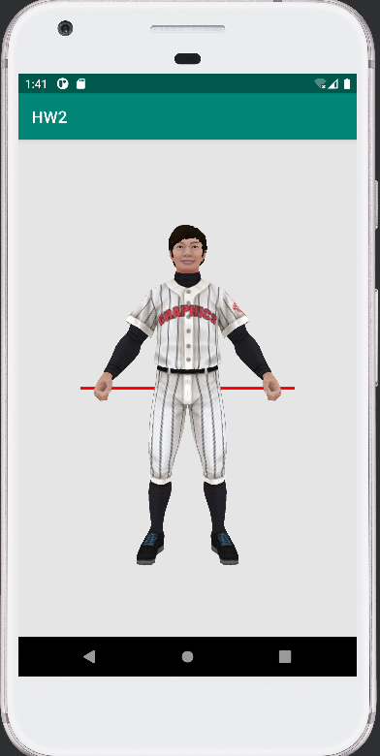
Initial state
Character is in T-pose.

Slide 4
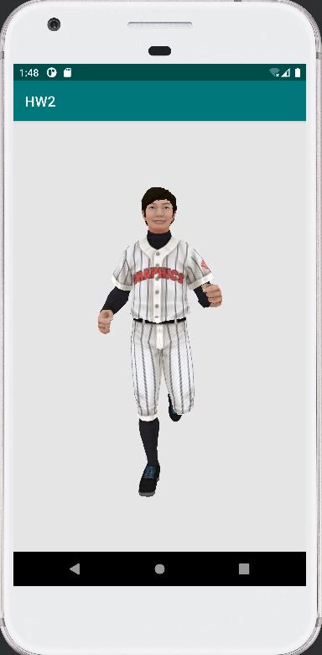
Final Result
Character run through the screen.

Slide 5
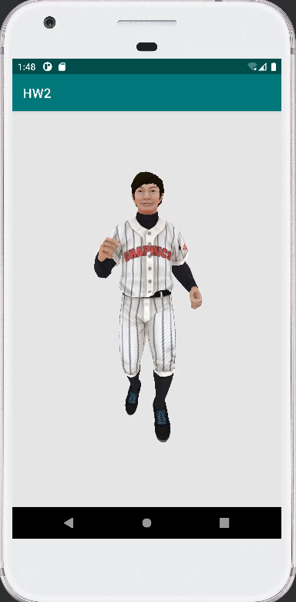
Final Result (optional)
Character rotates if you implements object rotating. (optional)

Slide 6
Skeleton data
The skeleton data will be provided in inc/binary/skeleton.h header file.
It has 28 joints including the root.
jNames[i] : the name of i-th joint
jParents[i] : the index of the parent of i-th joint
jOffset[i] : the offset between i-th joint and its parent joint

Slide 7
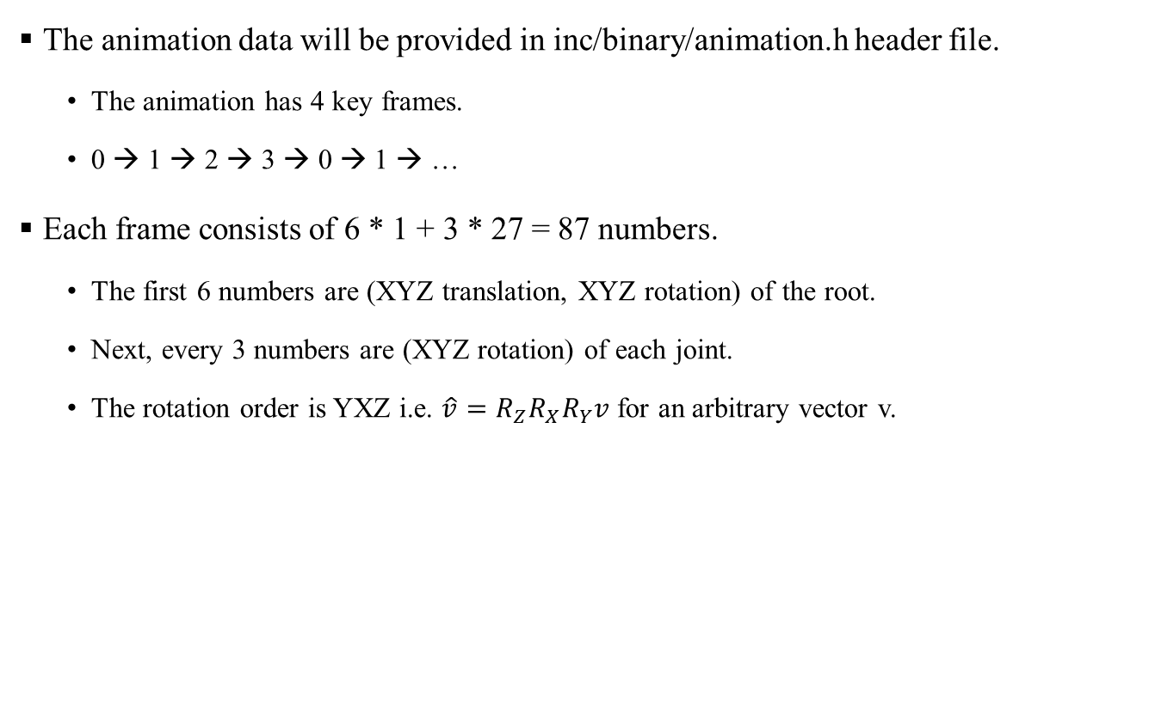
Animation data
The animation data will be provided in inc/binary/animation.h header file.
The animation has 4 key frames.
0 → 1 → 2 → 3 → 0 → 1 → …
Each frame consists of 6 * 1 + 3 * 27 = 87 numbers.
The first 6 numbers are (XYZ translation, XYZ rotation) of the root.
Next, every 3 numbers are (XYZ rotation) of each joint.
The rotation order is YXZ i.e. $\hat{v}=R_{Z}R_{X}R_{Y}v$ for an arbitrary vector v.

Slide 8
Mesh data
The mesh data will be provided in inc/binary/player.h header file.
playerTexels: the square texture
playerSize: the resolution of playerTexels
playerVertices: the mesh
playerIndices: the index of the mesh
Vertex structure is slightly modified for skinning.
Vertex.bone: the index of skinned skeleton
Vertex.weight: the weight of skinning

Slide 9
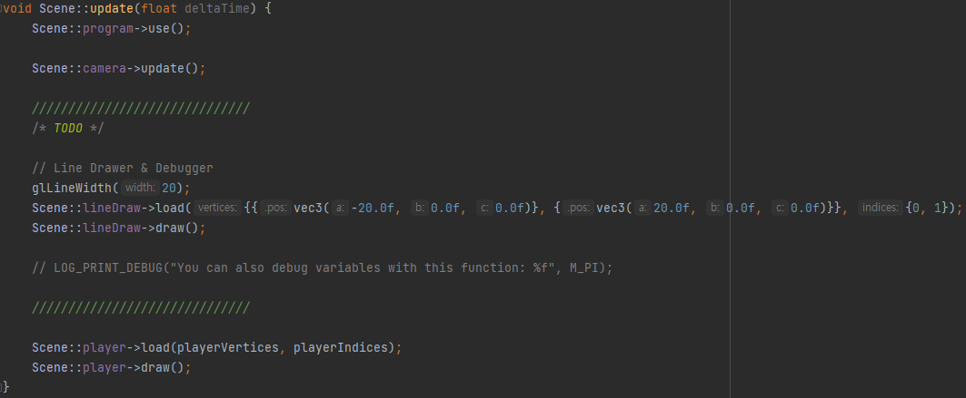
Problem
Write the code in Scene::update(float deltaTime) function.
Calculate the elapsed time from the start by accumulating deltaTime.
Repeat the animation every 4 seconds.
Convert the animation from Euler angles to quaternions.
Interpolate the animation.
Update VBO and IBO of the object.
Apply the skinning with the weight blending.

Slide 10
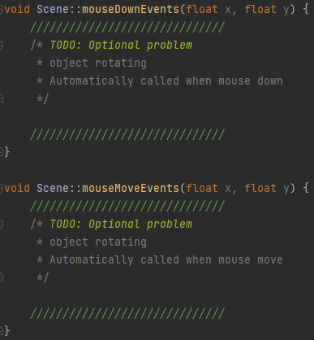
Problem (optional)
Rotate the character only when dragging the mouse.
You may fill in the mouseMoveEvents and mouseDownEvents.
The parameters x, y are the screen space coordinates.
The above methods are called automatically, so there is no need to worry about how it works.

Slide 11

Tip
You can use the OpenGL Mathematics (GLM) functions.
GLM is a C++ header only library for graphics software based on the GLSL specifications.
GLM functions are included in “app/src/main/cpp/inc/glm”.
Useful glm function
glm::rotate
glm::translate
glm::quat_cast
glm::mat4_cast
glm::mix
glm::slerp
Documentations can be found here. [link]

Slide 12
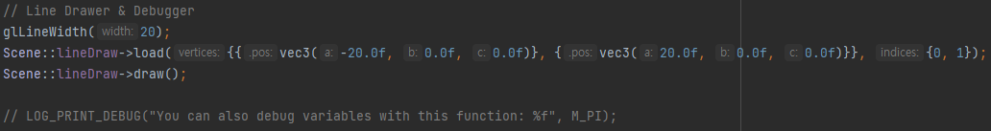
Tip
Visualize the skeleton.
The object with the line drawer will be provided.
Fill the VBO and IBO to visualize the skeleton.

Slide 13
Tip
Overlap the skeleton and the mesh.
If the skeleton and the mesh view the different direction, the result will be weird.
Apply the skinning without the weight blending.
The result is good enough.
The mesh and the skeleton are too big.
Note that the mesh is scaled down to 1/3.

Slide 14
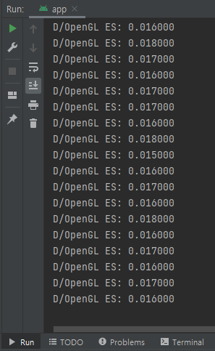
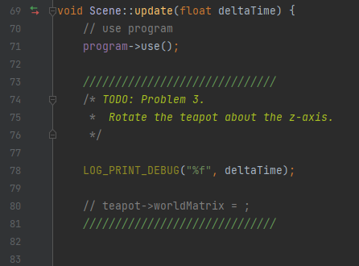
Tip
You can use LOG_PRINT_DEBUG() for debugging purposes
example)

Slide 15
Submission
Deadline
May 25 (Wed) 14:00
Submission files ({student_id}_{name}.zip)
app/src/main/cpp/src/scene.cpp
Please follow the submission format!!
Submission to Blackboard
Contact
TA email: 2022.CG.TA@gmail.com

Slide 16
Appendix: Android Studio Setup Guide

Slide 17
Android Studio
Android Studio is the official integrated development environment (IDE) for the Android platform.
Android Studio can be downloaded from the official website. [link]

Slide 18
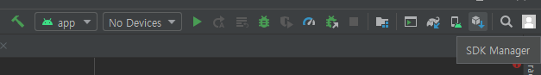
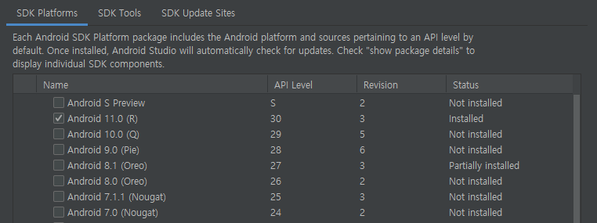
Android SDK
Android SDK can be installed through the SDK Manager in Android Studio.
The latest platform (API level 30) will be installed automatically.

Slide 19
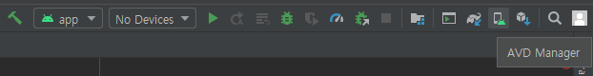
Android SDK
You may need to install additional platforms to try USB debugging on your smartphone.
Or you can use Android Virtual Device (AVD).
To use AVD, you need to enable hardware virtualization technology (shown as VT-x or SVM) in BIOS settings.

Slide 20
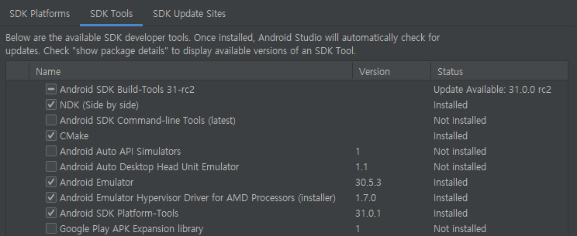
Android SDK
To use C++ native language on Android, you need to install the following tools.
CMake
NDK (Use version 19.2.5345600)

Slide 21
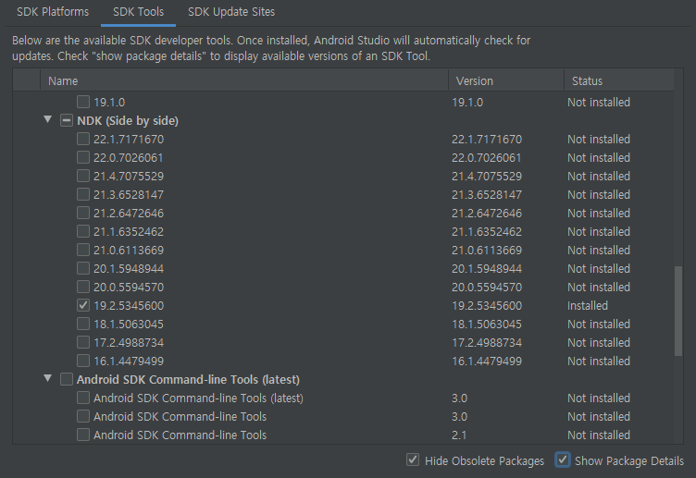
Android SDK
Use NDK version 19.2.5345600.

Slide 22
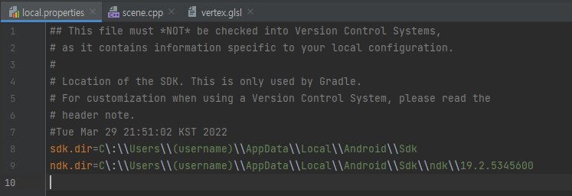
Gradle Sync
Before doing homework, you have to modify local.properties file.
Change (username) of ndk.dir and sdk.dir to your PC username.
Use the following path for MacOS device.
sdk.dir=/Users/(username)/Library/Android/sdk
ndk.dir=/Users/(username)/Library/Android/sdk/ndk/19.2.5345600

Slide 23
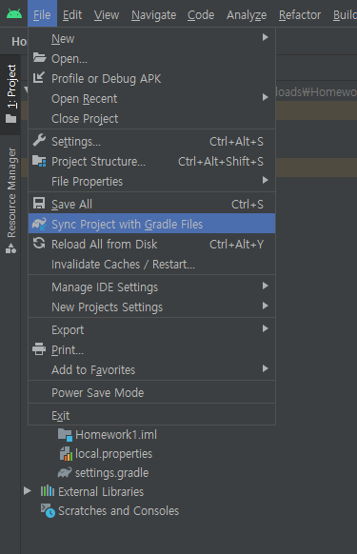
Gradle Sync
After modifying, sync project with gradle files.
Files – Sync Project with Gradle Files

